Slide 1
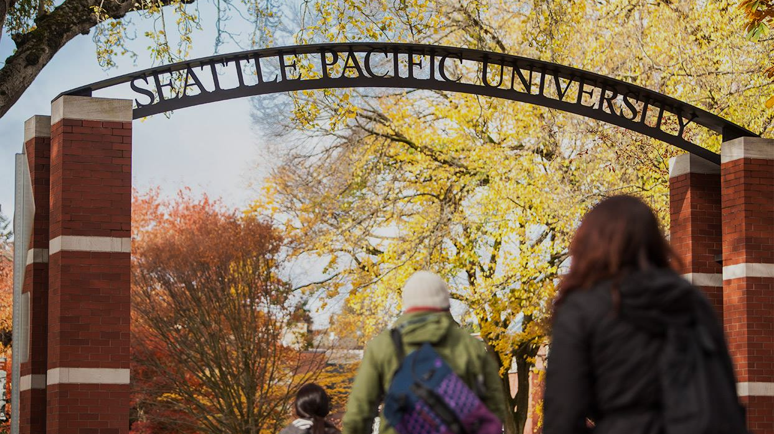
Writing Faith development narratives for pre-tenure, promotion & Tenure review files
Thursday, September 16, 2021, 10:00am-1:00pm, Emerson Hall Classroom
Facilitator: Dr. David Nienhuis

Slide 2
Opening Scripture – 2 Corinthians 1:3-7 (CEB)
³ May the God and Father of our Lord Jesus Christ be blessed! He is the compassionate Father and God of all comfort. ⁴ He’s the one who comforts us in all our trouble so that we can comfort other people who are in every kind of trouble. We offer the same comfort that we ourselves received from God. ⁵ That is because we receive so much comfort through Christ in the same way that we share so many of Christ’s sufferings. ⁶ So if we have trouble, it is to bring you comfort and salvation. If we are comforted, it is to bring you comfort from the experience of endurance while you go through the same sufferings that we also suffer. ⁷ Our hope for you is certain, because we know that as you are partners in suffering, so also you are partners in comfort.

Slide 3
Charles Wesley, “And Are We Yet Alive?” (1749)
1. And are we yet alive,
And see each other's face?
Glory and praise to Jesus give
For His redeeming grace.
2. Preserved by power divine
To full salvation here,
Again in Jesus' praise we join,
And in His sight appear.
3. What troubles have we seen,
What conflicts have we passed,
Fightings without, and fears within,
Since we assembled last.
4. But out of all the Lord
Hath brought us by His love;
And still He doth His help afford,
And hides our life above.
Notes:
Thomas Aquinas, The Book of Worship for Church and Home, UMC

Slide 4
Charles Wesley, “And Are We Yet Alive?” (1749)
5. Then let us make our boast
Of His redeeming power,
Which saves us to the uttermost,
Till we can sin no more.
6. Let us take up the cross
Till we the crown obtain;
And gladly reckon all things loss,
So we may Jesus gain.
Notes:
Thomas Aquinas, The Book of Worship for Church and Home, UMC

Slide 5
Unison Prayer
“Give us, O Lord, steadfast hearts that no unworthy thought can drag downward; unconquered hearts that no tribulation can wear out; upright hearts that no unworthy purpose may tempt aside.
Bestow upon us also, O Lord our God, understanding to know you, diligence in seeking you, wisdom to find you, and a faithfulness that may finally embrace you; through Jesus Christ our Lord. Amen.”
(St. Thomas Aquinas, 1225-74)
Notes:
Thomas Aquinas, The Book of Worship for Church and Home, UMC

Slide 6
Overview
Introductions and Goals
Basic Elements
    —Take a break—
A Close Look at the Faith Statement
Lunch and sharing

Slide 7
Self-Introductions
Name and Department
Years of service at SPU
What are you preparing for? Tenure? Promotion? Pre-Tenure Review?
Your Ecclesial Identity
  What church tradition formed you (if any)
  With whom do you now affiliate?

Slide 8
Goals of Today’s Workshop
Immediate goal: to assist faculty in drafting the narrative of their faith journey and statement of their Christian convictions and practices, a document required in pre-tenure review and tenure application files.

Slide 9
Goals of Today’s Workshop
Note: The goal is not to dictate what SPU faculty are “supposed” to believe…or say they believe…in order to receive tenure or promotion.
Rather, the goal is to help SPU faculty reflect critically on the extent to which, and the ways in which, their personal faith is congruent with the University’s official Statement of Faith.

Slide 10
Goals of Today’s Workshop
Larger goal: to encourage faculty to reflect on their personal faith insofar as it shapes and informs…
  their own teaching and research,
  their membership in the SPU community, and
  their contributions to Christian higher education.
Note: This larger goal entails more than the production of a document. It is part of the formation of a Christian vocation (notice that your vocation essay follows your faith essay).

Slide 11

II. Basic Elements
What the Handbook requires
What the Faculty Status Committee hopes to see
Compositional Strategies
Note: We’ll take a coffee break when the time seems right

Slide 12
1. What the Faculty Handbook requires
The description of the essay is identical for all three FSC performance reviews:
Content of all review files – FH 10.2
Pre-Tenure Review described – FH 10.3
Tenure Review described – FH 10.5
Promotion Application described – FH 10.8
Notes:
http://www.swotti.com/tmp/swotti/cacheDGHLIHRLBIBJB21TYW5KBWVUDHM=RW50ZXJ0YWLUBWVUDC1NB3ZPZXM=/imgthe%20ten%20commandments5.jpg

Slide 13
1. What the Faculty Handbook requires
Part I of your file: “Primary documents”
Curriculum Vitae [5 pages]
Faith Statement [4 pages]
Vocation Statement [4 pages]
Teaching Assessment [4 pages]
Scholarly Trajectory [2 pages]
Service Activities [2 pages]
Advising Assessment [2 pages]
Three Quick Keys to Success:
Stay within page limits!
Make use of proofreaders!
Strive to create an overall portrait of coherence
Notes:
http://www.swotti.com/tmp/swotti/cacheDGHLIHRLBIBJB21TYW5KBWVUDHM=RW50ZXJ0YWLUBWVUDC1NB3ZPZXM=/imgthe%20ten%20commandments5.jpg

Slide 14
1. What the Faculty Handbook requires
The exact wording of the Faculty Handbook:
“A narrative that describes the development of the candidate’s faith over the years, reflects the candidate’s affirmation of the central claims of historic Christian teaching, interacts with the SPU Statement of Faith, and provides some indication of the current practices that form and sustain the candidate’s faith and life–including participation in a local church.”

Slide 15

2. What the Faculty Status Committee hopes to see
Notes:
http://torahmusings.com/wp-content/uploads/2010/07/judge.jpg

Slide 16
Preferred format for the Faith Development Essay
A 4-pg document with 3 distinct yet intentionally interrelated content areas:
(1) A narrative of your faith journey;
(2) A statement of your core Christian beliefs, giving explicit attention to the way in which the candidate understands and is, in good conscience, able to embrace the official SPU Faith Statement
(3) An account of the current spiritual disciplines and faith practices that form and sustain the candidate’s faith and life, including participation in a local church.

Slide 17
Key Distinction:
“Mission fit” and “Professional Performance”
The primary (though not exclusive) focus of pre-tenure review and tenure application is a candidate’s “Christian mission fit” (the Faith and Vocation essays are important!)
The primary focus of promotion application is “professional performance” (teaching, advising, scholarship, and service to University, church, and community).
NOTE: “Mission fit” is largely measured in reference to the SPU Faith Statement!

Slide 18

3. Compositional Strategies
Notes:
http://1.bp.blogspot.com/_AIXW_vy7XNc/SwLCRF7Ym6I/AAAAAAAADIg/ugRfzKcfE1A/s1600/CredoVII.jpg

Slide 19
Three main objectives:
Your faith statement must include the following:
  A narrative of how you came to faith
  A statement of your core Christian beliefs in relation to the SPU Faith Statement
  A description of your current spiritual disciplines and faith practices.
  Note: you’ll want to write single-spaced…

Slide 20
Three main objectives:
A narrative of how you came to faith.
  Tell the story of what has most influenced your spiritual growth
    What people have shaped your faith? Parents, pastors, friends…
    What institutions have shaped your faith? Congregations, schools…
    What experiences have shaped your faith? Life-changing experiences, events, conversations...
  Try to keep this to no more than two of your four pages

Slide 21
Three main objectives:
2. A statement of your core Christian beliefs in relation to the SPU Faith Statement
Again, the goal is to reflect critically and honestly on the extent to which, and the ways in which, your personal faith is in harmony with the University Statement of Faith.
In one way or another, you must engage explicitly with the four “marks” of the SPU Faith Statement.
  Consider using boldface to highlight each mark in your essay
This will typically absorb at least a single page, sometimes more.

Slide 22
Three main objectives:
3. A description of your current spiritual disciplines and faith practices
  What habits and practices form and sustain your faith life?
  Provide clear indication of your participation in a local church
  Use this as a place to “tie everything up” – i.e. explain how your story and your beliefs are given expression in these practices.
  Often the shortest section (less than one page) but do not scrimp here!

Slide 23
Let’s take a break

Slide 24
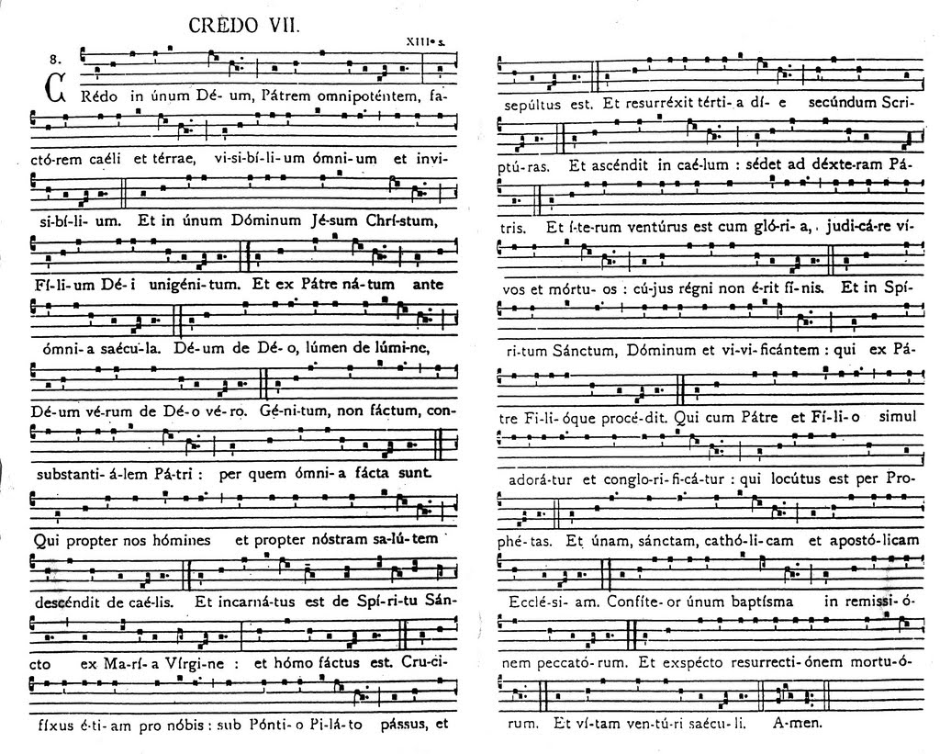
III. Exploring the SPU Statement of Faith
Notes:
http://1.bp.blogspot.com/_AIXW_vy7XNc/SwLCRF7Ym6I/AAAAAAAADIg/ugRfzKcfE1A/s1600/CredoVII.jpg

Slide 25
The SPU Statement of Faith
Take a few moments to read the document over. What strikes you as significant? Confusing? Is anything missing? Over- or under-stated?
Five Main Parts (see handout)
Preamble: Faith and Mission
We are Historically Orthodox
We are Clearly Evangelical
We are Distinctively Wesleyan
We are Genuinely Ecumenical

Slide 26

Preamble: Faith and Mission
What do you take to be the key words in this section?
What do these words suggest about how SPU’s Statement of Faith seeks to regulate our common life?
  Transforming gospel
  Personal commitment / corporate aspiration
  Diversity / anchor
Notes:
http://www.spu.edu/depts/ugadm/etc/magazine/2010-summer/collegekids.asp

Slide 27
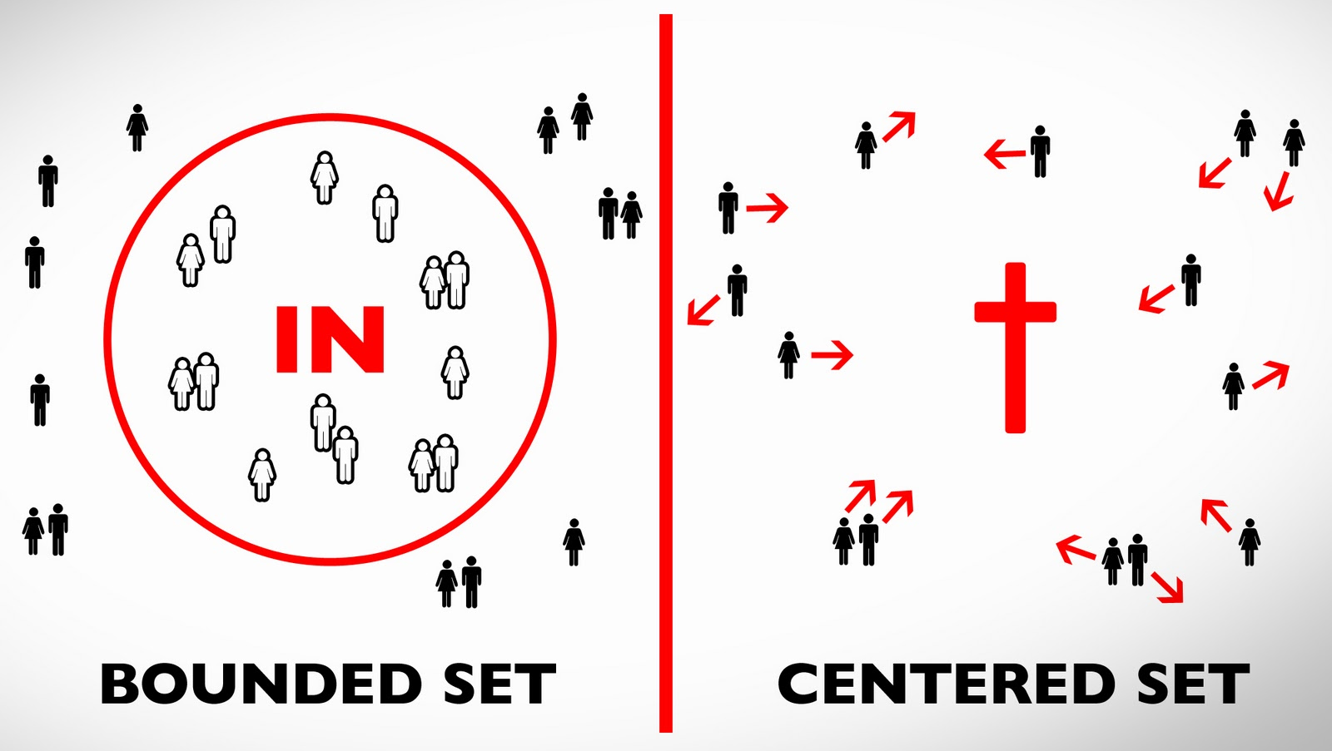
Two Ways of Defining Institutional Identity
By defending the boundaries
By living from a common center
The FS describes SPU as a centered set, but this is hard to pull off…
Notes:
L: http://competitionwheelssa.com/media/catalog/product/cache/1/image/9df78eab33525d08d6e5fb8d27136e95/v/e/ve_219bm_10spoke.jpg
R: http://www.flexijourney.com/blog/wp-content/photos/2010/07/HC-800px-PingYaoCityWall.jpg

Slide 28
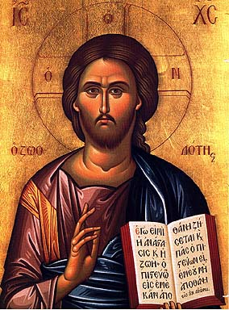
1. Historically Orthodox
What does the Statement affirm about…
  The sources of our knowledge of God?
  The nature of God?
  The purposes of God?
  Human nature, human need?
  The mission of the church?
Notes:
http://upload.wikimedia.org/wikipedia/commons/0/04/First_Council_of_Nicea-stavropoleos_church.JPG

Slide 29
1. Historically Orthodox
Things you might consider when writing your essay…
  How “fluent” do you feel when it comes to articulating basic Christian belief?
  How does your part of the SPU curriculum reflect, or engage with, these core Christian affirmations?
  In your experience, to what extent does campus life at SPU reflect these affirmations?
Notes:
http://upload.wikimedia.org/wikipedia/commons/0/04/First_Council_of_Nicea-stavropoleos_church.JPG

Slide 30
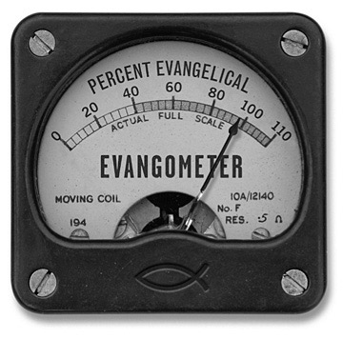
2. Clearly Evangelical
How does the Statement understand the term “evangelical”?
  Evangelicalism is a broad tradition
  Jesus as Savior
  Scripture is primary authority
  Holy Spirit transforms our lives
  Practice what we preach: piety, testimony, service
What other common understandings of that term are implicitly rejected?
Notes:
http://oasis-church-nj.com/wp-content/uploads/2008/10/evangelical-church.jpg

Slide 31
2. Clearly Evangelical
Things you might consider when writing your essay…
  If you identify as “Evangelical,” how does SPU’s definition sit with you?
  If you aren’t from a conventionally “Evangelical” tradition, to what extent are you able champion SPU’s description of the term?
  How does our identity as an “evangelical” institution shape the way you teach your subject? How do you handle apparent “conflicts” between scripture and the findings of your discipline?
  How does our “evangelical” identity shape the way you interact with “non-Christian” students?
Notes:
http://oasis-church-nj.com/wp-content/uploads/2008/10/evangelical-church.jpg

Slide 32
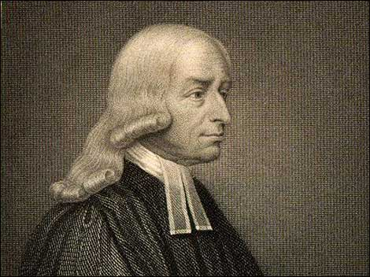
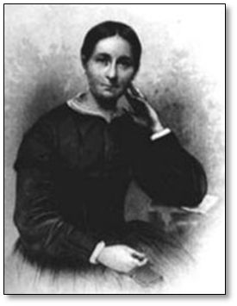
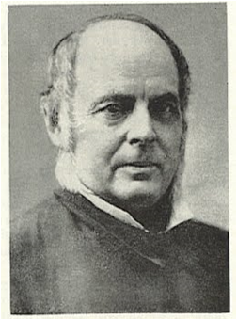
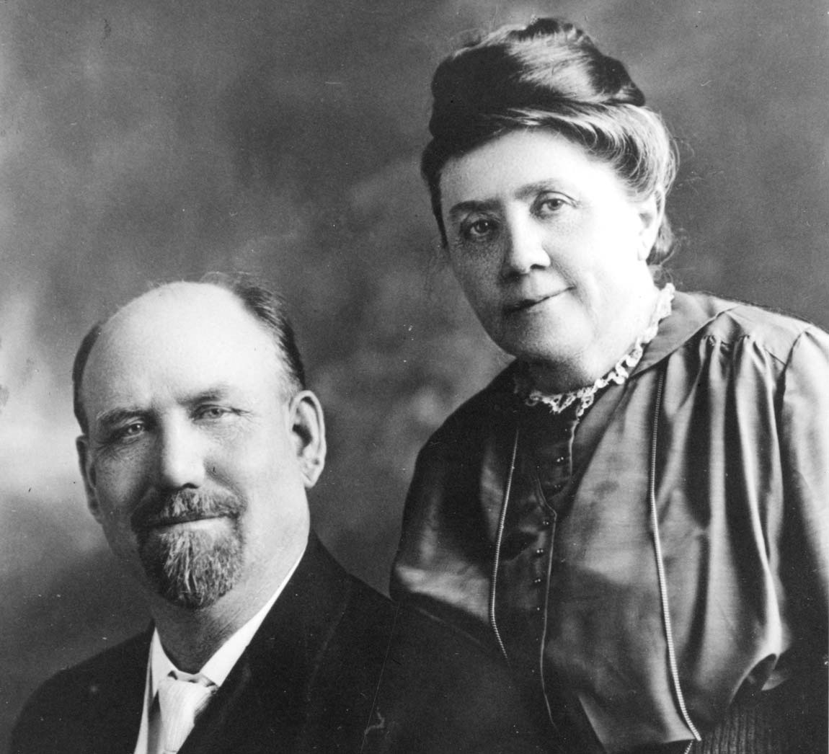
3. Distinctively Wesleyan
What does the Statement emphasize about the “theological legacy” of John and Charles Wesley?
How does “the Wesleyan holiness branch of historic and evangelical Christianity” differ from other branches of the faith?
John Wesley (1703-91),
Founder of Methodism
Phoebe Palmer (1807-1874),
Methodist evangelist and “Mother
of the Wesleyan Holiness Movement”
Benjamin Titus Roberts (1823-93), Founder of Free Methodism
Alexander and Adelaide Beers, Founders of Seattle Seminary (1891)
Notes:
Wesley: http://lexloiz.files.wordpress.com/2010/03/john-wesley.jpg
Roberts: Roberts: http://4.bp.blogspot.com/_pAEUCEW6YeY/S00aqH5IVOI/AAAAAAAAFM8/yorgBmJ6Cm8/s1600-h/BTRoberts.jpg

Slide 33
3. Distinctively Wesleyan
Things you might consider when writing your essay…
  How does the ethos of a “Wesleyan holiness” university differ from that of other Christian universities? Is that difference apparent here at SPU?
  What difference does it make for you that you teach at a “distinctively Wesleyan” university?
  In your judgment, what role should representatives of the denomination that founded SPU, the FMC, play in setting curricular goals and campus life policies?
Notes:
Palmer: http://isae.wheaton.edu/hall-of-biography/phoebe-palmer/
The Way of Holiness: http://www.tower.com/way-holiness-phoebe-palmer-hardcover/wapi/113284409
Roberts: http://www.indybikehiker.com/2010/01/quoting-b-t-roberts.html
Holiness Teachings: http://wesleyanbooks.com/mm5/merchant.mvc?Screen=PROD&Store_Code=WB&Product_Code=1902&Category_Code=WAHOL

Slide 34
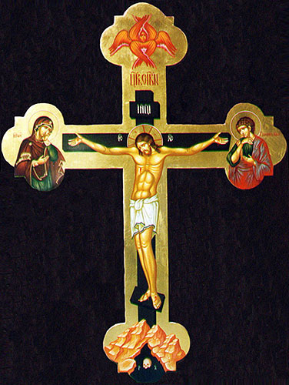
4. Genuinely Ecumenical
The Statement claims that “theological diversity, when grounded in historic orthodox and a common and vital faith in Christ, enriches learning….”
  Note the qualifiers… for “diversity” to be meaningful, a center is required (otherwise it’s just “difference”).
Notes:
http://blog.ancient-future.net/2009/03/06/living-perfectly-aquinas-on-the-example-of-christs-passion/

Slide 35

4. Genuinely Ecumenical
Reflects a more comprehensive, less partisan understanding of “the Church” – a “generous orthodoxy”
The foliage and fruit are the local churches and Christians
The branches are the major historic sub-traditions (i.e. Lutheran, Roman Catholics, Reformed, Wesleyan…)
The trunk that supports us all is the God who is known by the central authorities of our common faith
(Scripture, Creeds, Key Practices)
This view is deeply rooted in Wesley’s call for believers to maintain a “catholic spirit”
Roots are in Judaism
Notes:
http://blog.ancient-future.net/2009/03/06/living-perfectly-aquinas-on-the-example-of-christs-passion/

Slide 36
4. Genuinely Ecumenical
What “ecumenical” does not mean for SPU:
  Does not mean “interfaith” or “interreligious”
  Does not mean that SPU is “non-denominational”. Not all traditions of Christianity are ecumenical!
  Does not mean promoting diversity for diversity’s sake
  Does not mean indifference to doctrines, modes of worship, or moral perspectives
Notes:
http://blog.ancient-future.net/2009/03/06/living-perfectly-aquinas-on-the-example-of-christs-passion/

Slide 37
4. Genuinely Ecumenical
Things you might consider when writing your essay…
  What are the benefits and costs of this ecumenical stance to the spiritual and academic life of the University?
  What are the benefits and costs to your own spiritual development and professional work here?
Notes:
http://blog.ancient-future.net/2009/03/06/living-perfectly-aquinas-on-the-example-of-christs-passion/

Slide 38


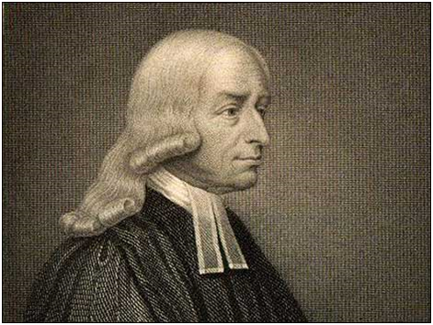

“Therefore…
…we commit ourselves to this faith, and to these shaping influences that define our community of faith, and we pledge ourselves, with humility and conviction, to live as best we know how in loving relationship with Jesus Christ and in faithful service to others. This we believe to be the defining center of our lives and the guiding aspiration of our life in community at Seattle Pacific University.”
Notes:
http://blog.ancient-future.net/2009/03/06/living-perfectly-aquinas-on-the-example-of-christs-passion/

Slide 39
Opening sharing
Orthodox, Evangelical, Wesleyan, Ecumenical.
  Which of these four terms is most central to the way you understand yourself as a Christian and as a Christian teaching scholar? Why?
  Which of these four terms is least central to the way you understand yourself as a Christian and as a Christian teaching scholar? Why?

Slide 40
IV. Continue the Conversation over Lunch!
NOTE: Participation in this workshop entitles you to a consultation from the facilitator on a draft of your faith statement.
Please submit it to me at least two weeks before your tenure, promotion or third-year review file is due to your dean.
Notes:
http://uppitynegronetwork.files.wordpress.com/2008/10/sunday-morning-coffee-break.jpg

